Slide 1
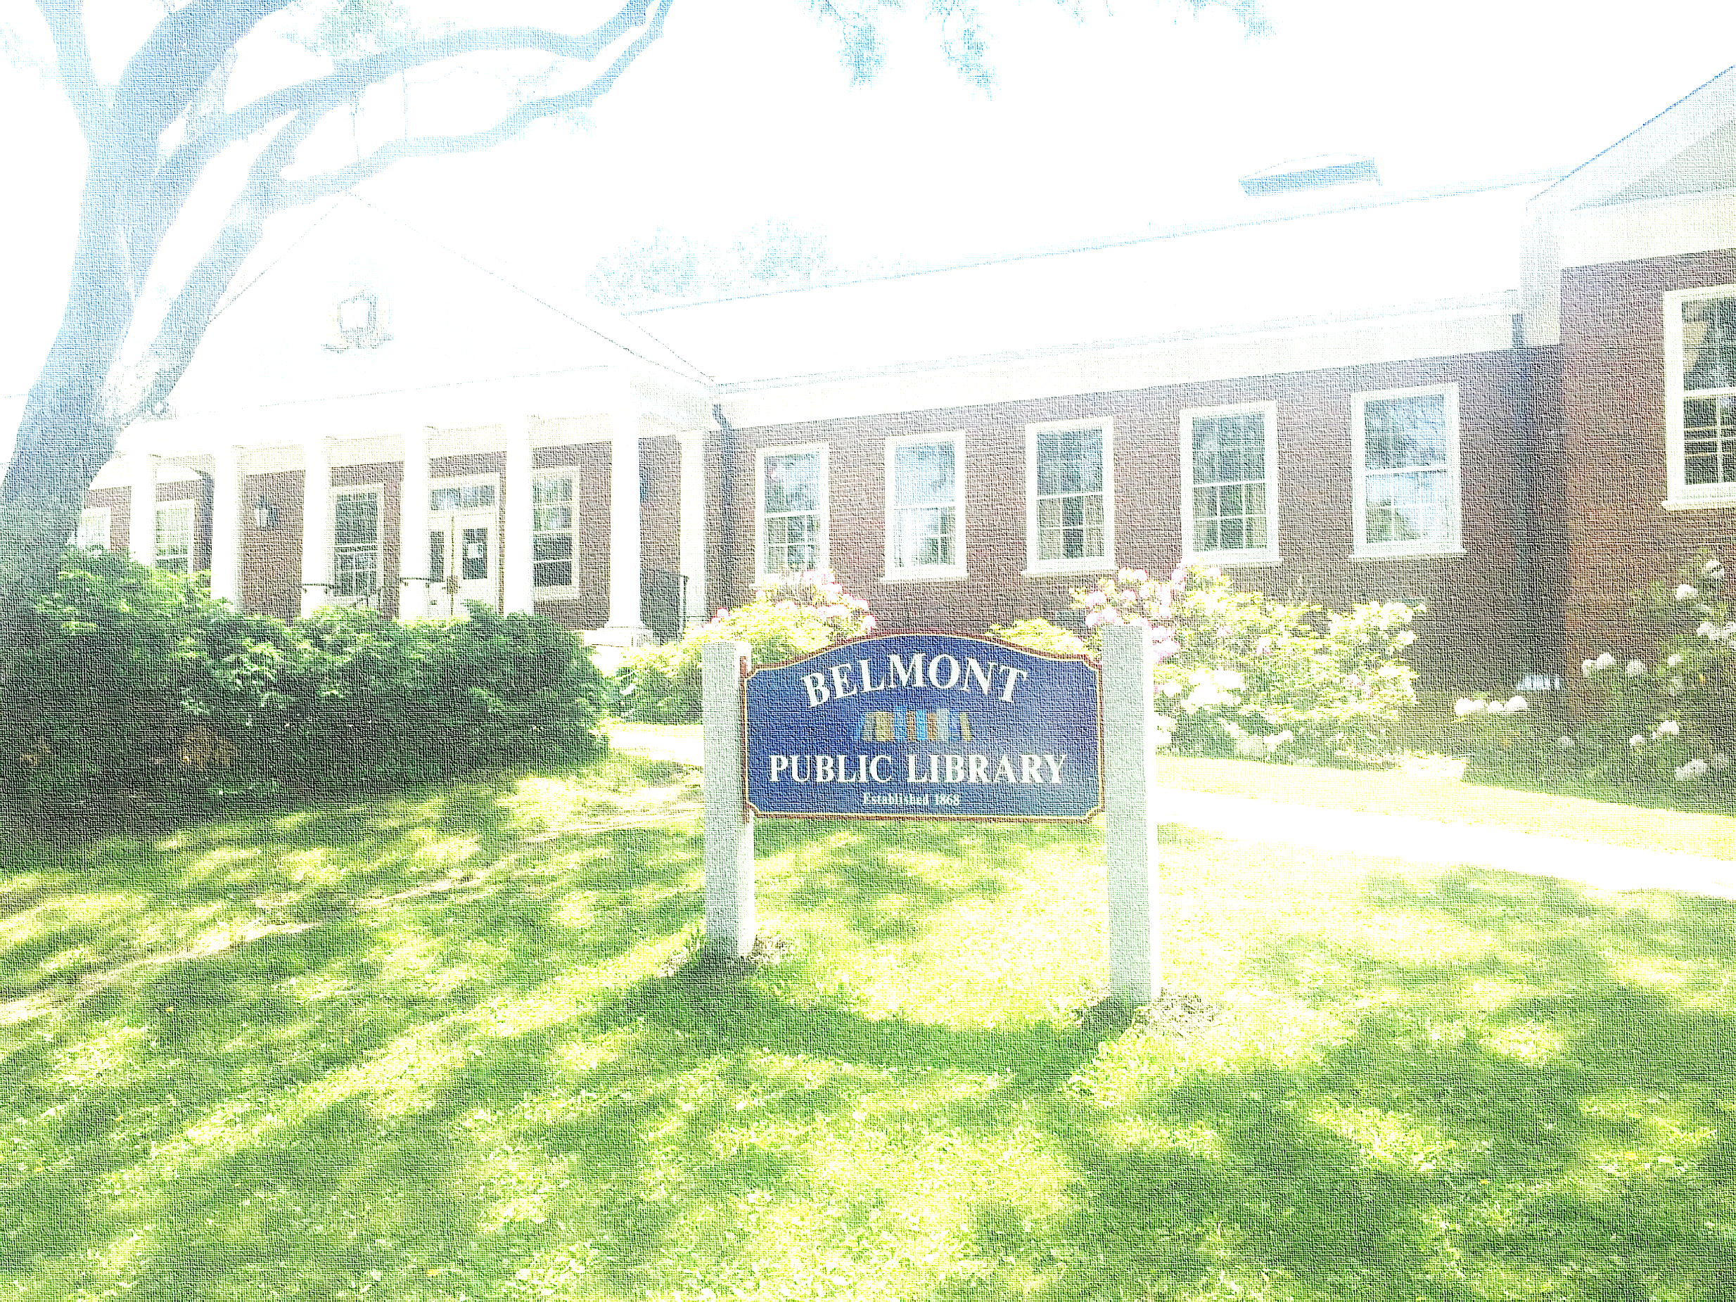
Kathy Keohane – Chair Board Of Library Trustees
Belmont Public Library
Feasibility Study Update
June 2016

Slide 2
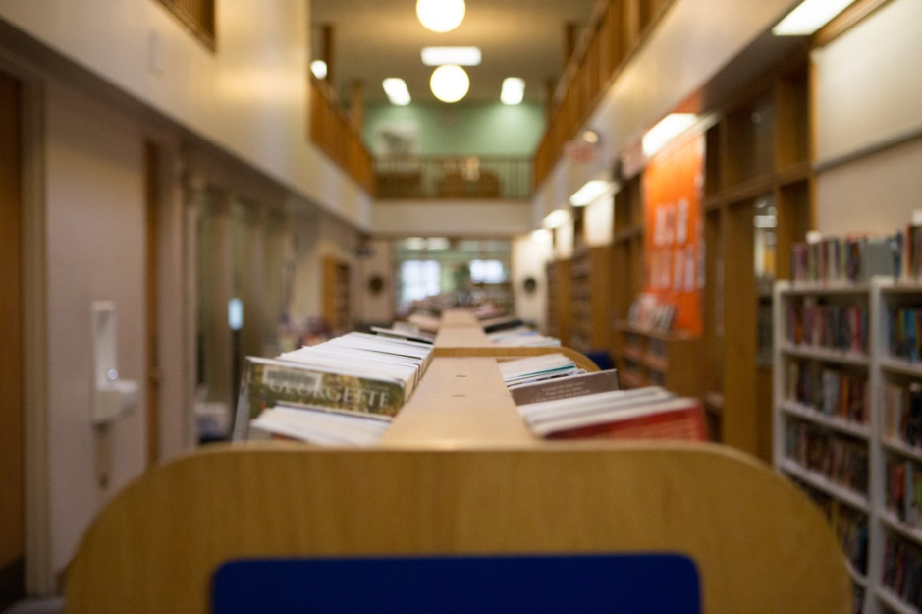
Why a Feasibility Study?
Agreement at June 2015 Town Meeting to fund feasibility study
No significant investment in building for a number of years; core systems original to the building (50+ yrs)
Building design and layout no longer meets community needs
Prior studies focused on replacement
Scope of Study:
Renovation
Renovation with Addition
Replacement

Slide 3
What We Have Accomplished
January 2016 February 2016 May 2016 June 2016
Developed Long Range Plan
Appointed
Feasibility Committee
CompletedRFQ Process
Select and Onboard Architect
Developed Long Range Plan outlining programs and services
Developed with LRP committee in fall of 2015
Approved by Trustees in Dec 2015
Submitted to state and approved Jan 2016
Plan available on Library website
Appointed Committee and Subcommittee
Leveraged consultant to assist with the development of supporting materials
Created required documents for RFQ
Documents available on Library website
RFQ sent to state register
Process managed by Gerry Boyle and Facilities Department
Conducted pre-bid meeting and building tour
Final submissions were due June 2nd
Reviewing Qualifications

Slide 4
Plan Moving Forward
July/August 2016 September/October 2016 Late Fall 2016
Architectural
Tasks
Conceptual Ideas
Develop and Present
Recommendations
Hold public meeting to gather input
Familiarization with site and former studies
Meetings with staff
Regular meetings with Feasibility Committee to show progress
Develop ideas to share for feedback
Assess 3 Options
Renovation
Add/Reno
New Building
Creation of cost estimates for each
Holding of 2nd public meeting for additional input
Review recommendation with key stakeholders
Board of Selectman
Capital Budget
Community
Town Meeting Members
Review proposal with Library Board of Trustees

Slide 5
It’s your Library and your input is KEY
Feasibility Committee
Elaine Alligood- Co Chair Nancy Dignan Co Chair Gail Mann
Gerry Boyle Jenny Fallon Anne Paulsen
Pat Brusch Hannah Fischer Joel Semuels
Clair Colburn Kathy Keohane Peter Struzziero
Board Of Library Trustees
Kathy Keohane – Chair Elaine Alligood – Vice Chair
Gail Mann- Secretary Mark Carthy
Mary Stearns
Library Director – Peter Struzziero

Slide 6
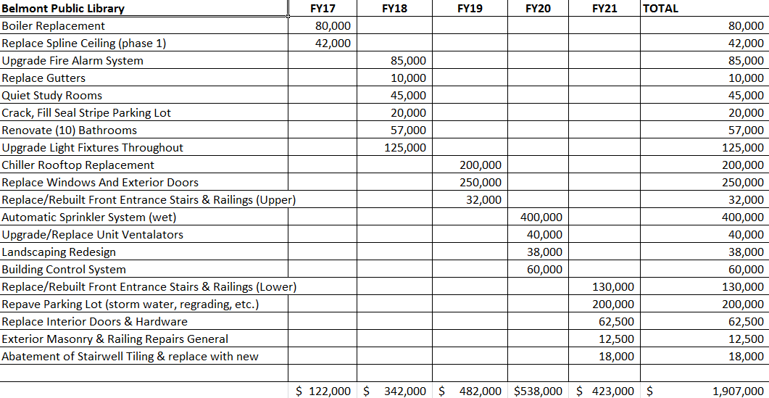
Supporting Materials
Capital plan focused largely on required/must do maintenance
Plan developed with Facilities Department
Considerations with ADA and MAAB requirements/obligations

